Slide 1




Steam Application Recommendation Engine (SARE)
David Lin
Utilizing user data from steam and ensemble methods to recommend Apps based on user ID and App ID

Slide 2
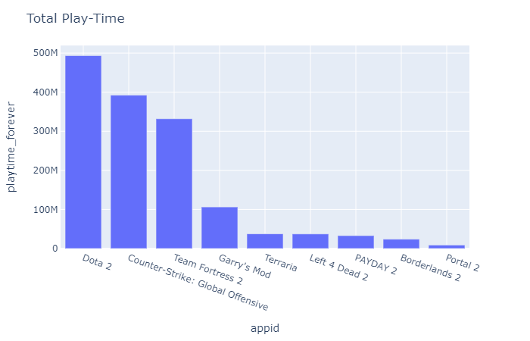
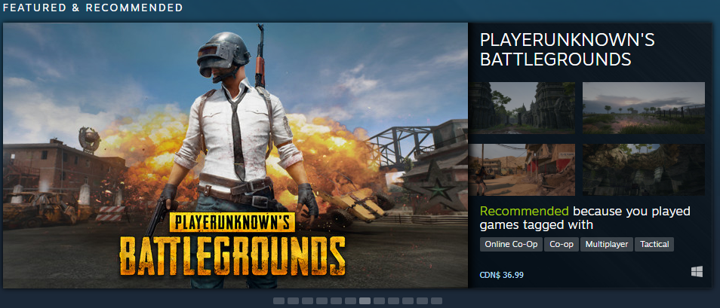
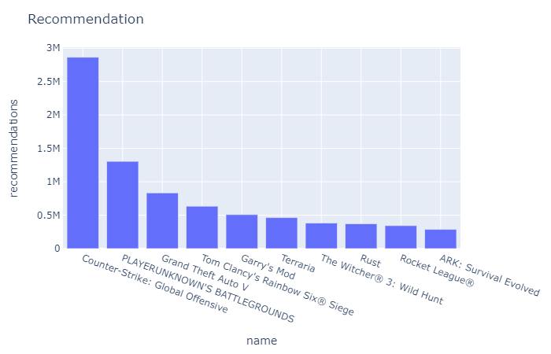
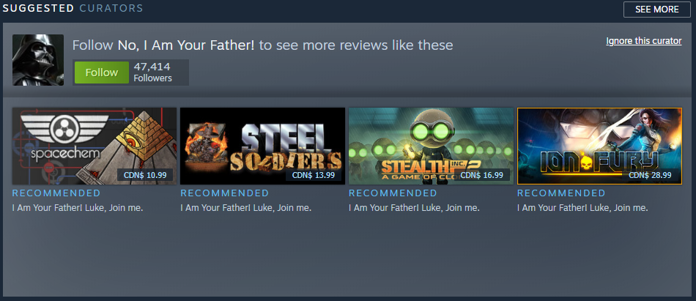
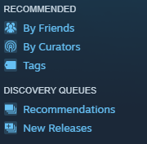
Motivation

Slide 3
Features
Recommendation for new users with no user data
- Takes in “game” as a parameter and returns similar popular applications
- Optionally takes in “top” as parameter for number of returned Apps (default = 3)
2) Recommendation for users on the platform
- Takes user “ID” as parameter and returns App recommendation based on user info
- Optionally takes in “top” as parameter for number of returned Apps (default = 3)
3) Rating prediction for specific user and application
- Takes “UserID” and “game_ID” as parameters and returns an estimated rating (0-5)
4) Database Query
- Game ID to Game name (Vise Versa)
- Returns list of users and games

Slide 4
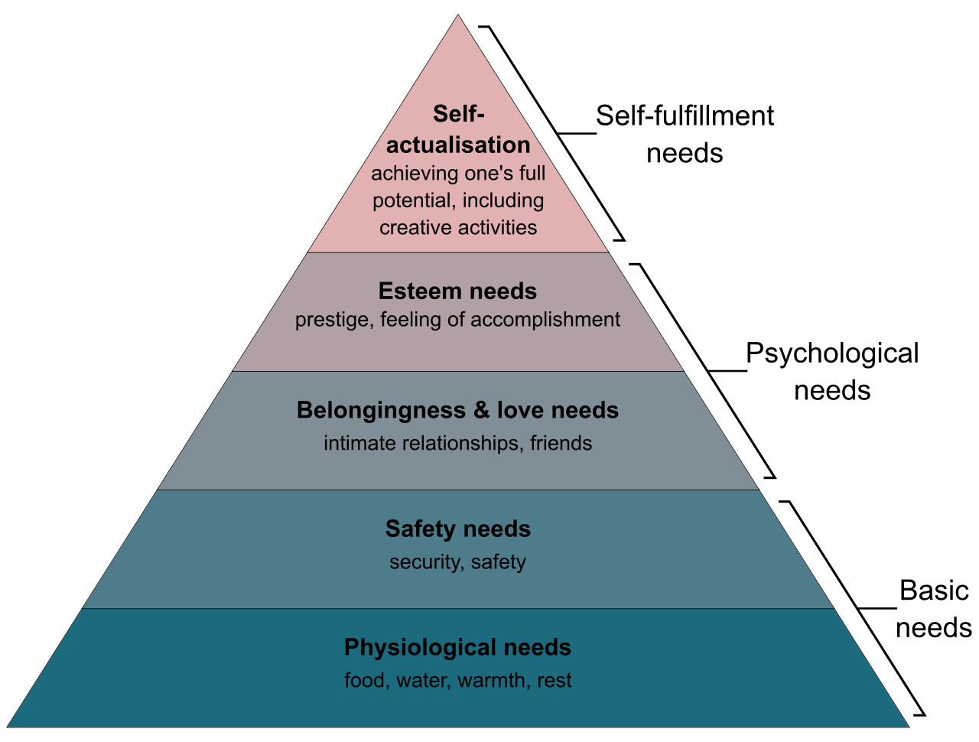
Extension
Scalability
- Update database with user and game data
- Online learning to train model (SVD++ and KNN)
Adaptability
- Engine can easily be applied to other fields
- Online learning to train model

